Slide 1
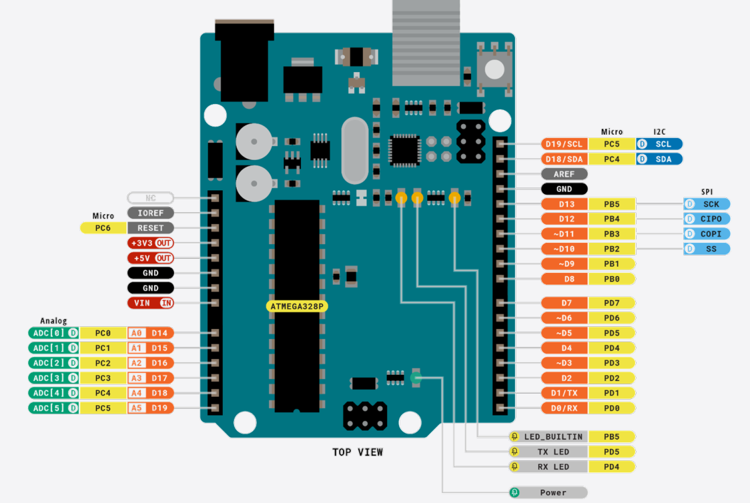
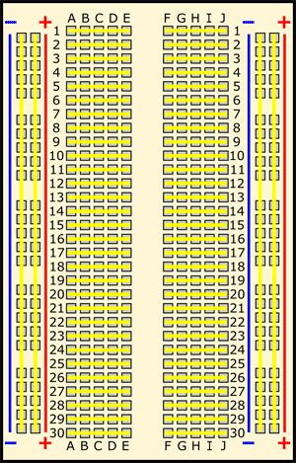
Preliminary, Step 1, Connect the positive and negative poles

Slide 2
PRE, Step 2, Connect the LED circuit
+
-
+
-

Slide 3
Task1, Step 1, Connect the positive and negative poles

Slide 4
PRE, Step 2, Connect the thermistor circuit
+
-
+5v
Analog pin
GND

Slide 5
Task2,3, Base on Task 1, add LEDs
+
-
D2/D3/D4
GND
+
-

